Slide 1
IOT GPS Tracker
Team members
R Nikhil Yadav – 1602-19-735-146
B Sushanth – 1602-19-735-168
Ch Vamshi – 1602-19-735-172

Slide 2
Flow Chart
Introduction
Components
Circuit Diagrams
Advantages
Applications

Slide 3


Introduction

Slide 4
Components
Nodemcu ESP8266
OLED Module
Neo-6M GPS Module
18650 Lithium Cell
18650 Lithium Cell Holder
Breadboard
Jumper Wires

Slide 5
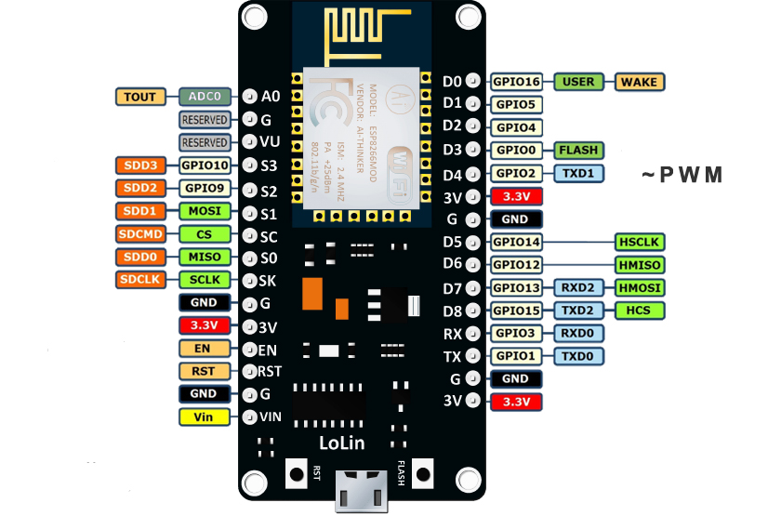
Nodemcu ESP8266

Slide 6
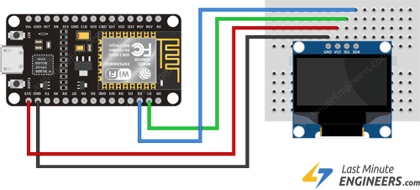
OLED Module

Slide 7
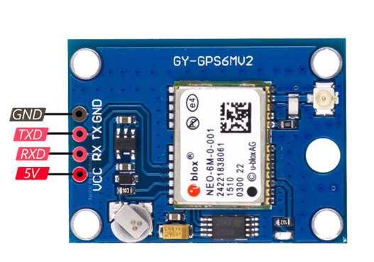
Neo-6M GPS Module

Slide 8
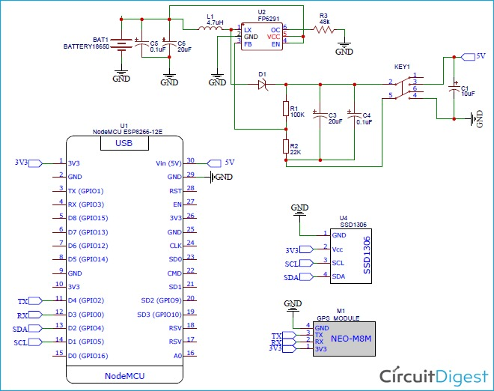
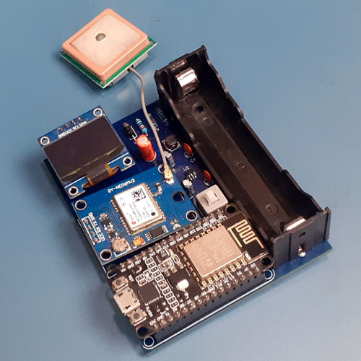
Circuit Diagram

Slide 9
Advantages
Portable
Improved Safety
Protection against theft
Application(Extension)
In the near future as there will be no toll booths on highways, we planned a car with this GPS tracker which tracks the distance travelled by car and generates the toll tax based on the number of kilometres travelled by the car.

Slide 10
Thank You

